Slide 1
Cardiograph Project
Josh Lopez and Joey Wong-Vermillion

Slide 2
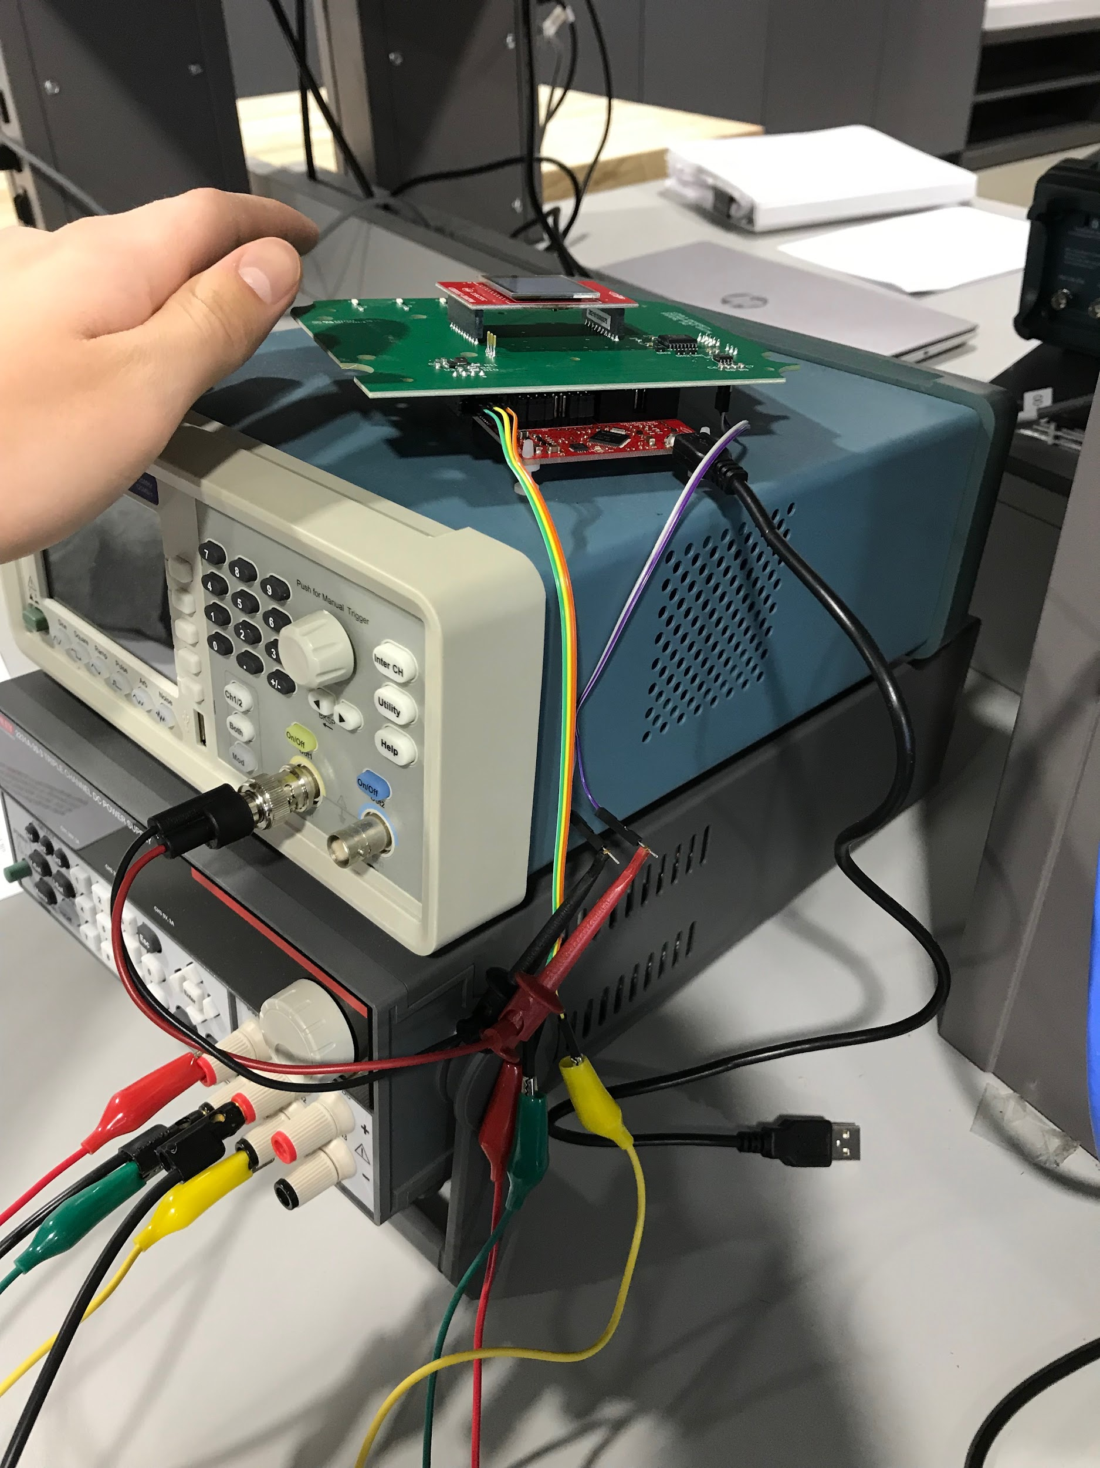
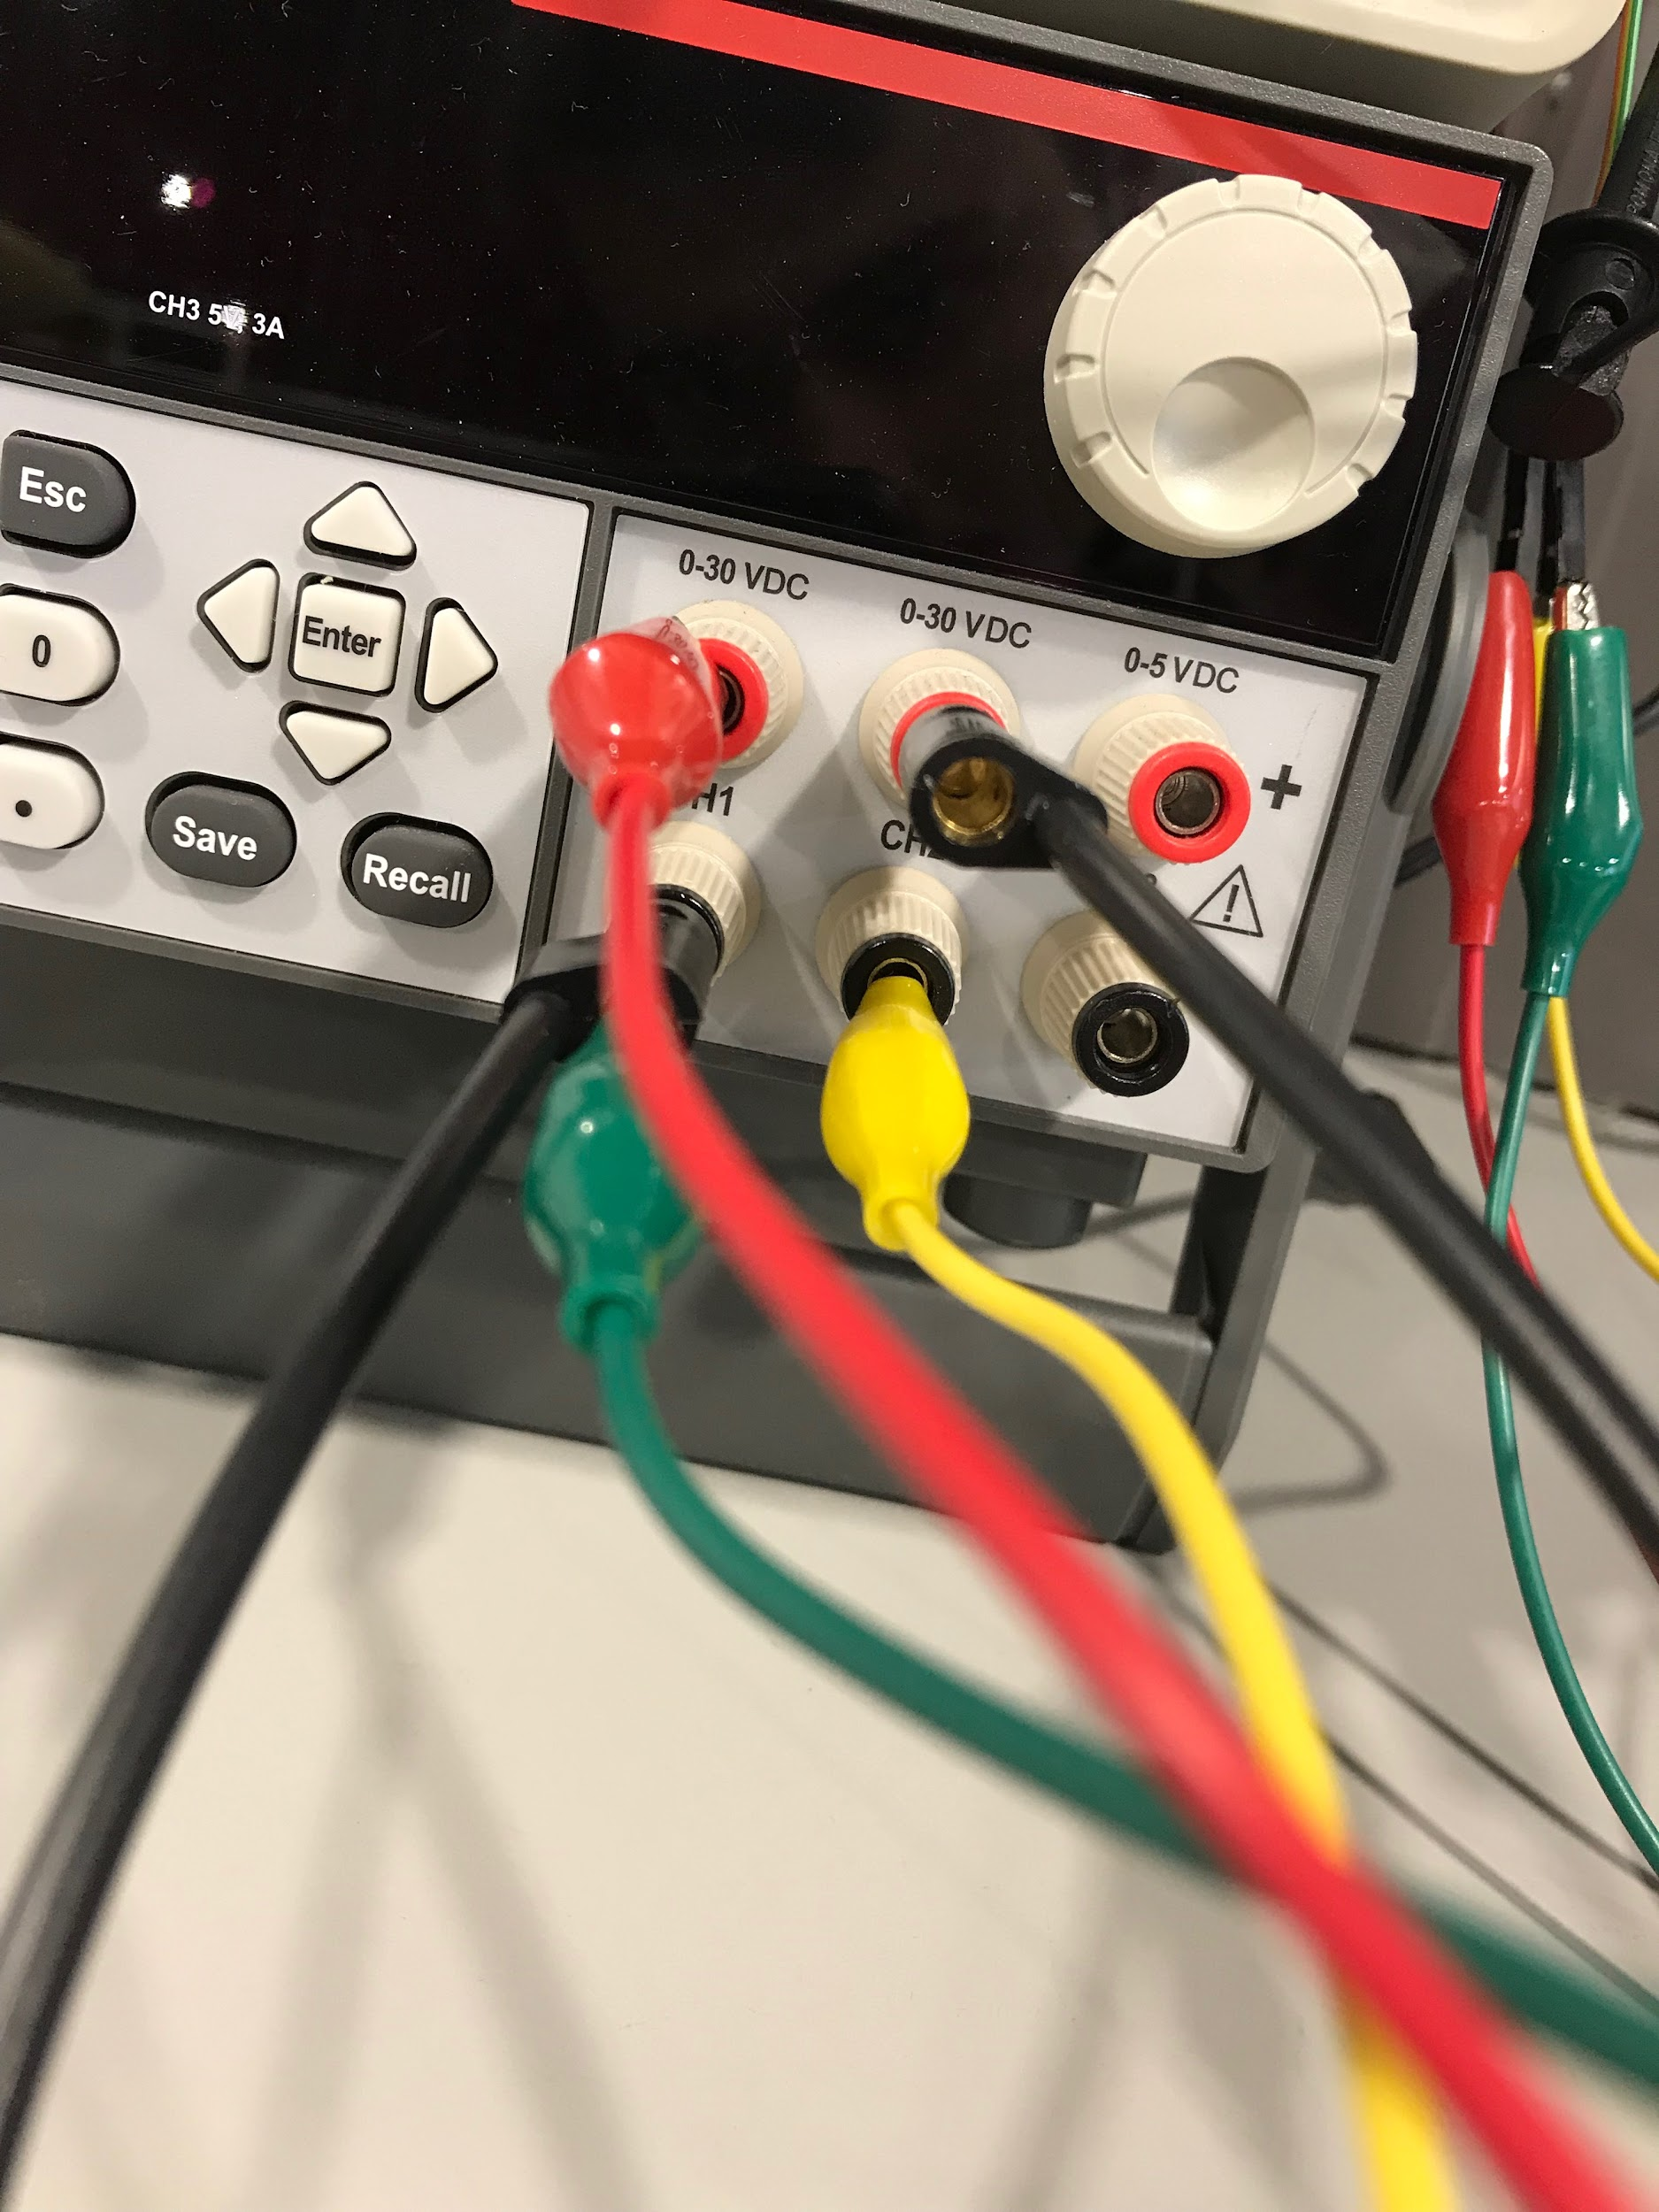
Setup

Slide 3
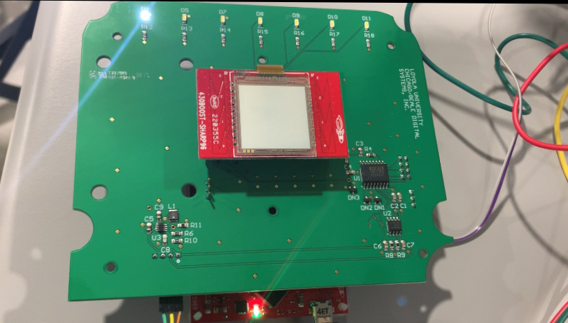
LED Blinking

Slide 4
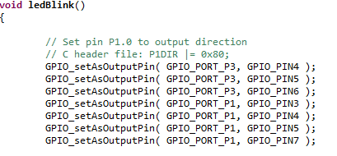
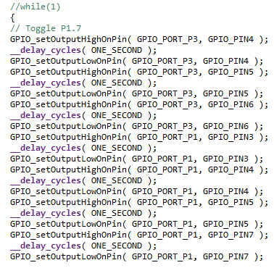
LED Blinking(cont.)
In order to have had the 7 LEDs blink sequentially, we needed to create a function that contained those commands.
GPIO_setAsOutputPin(); created an output for each pin.
Then turning the signal on HIGH, then delaying and setting it to low caused the signal to switch on and off. Then repeating for 6 other pins.
In order to get the rest of the actions to run we omitted the while loops to prevent it from running infinitely.

Slide 5
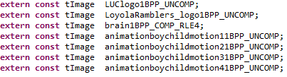
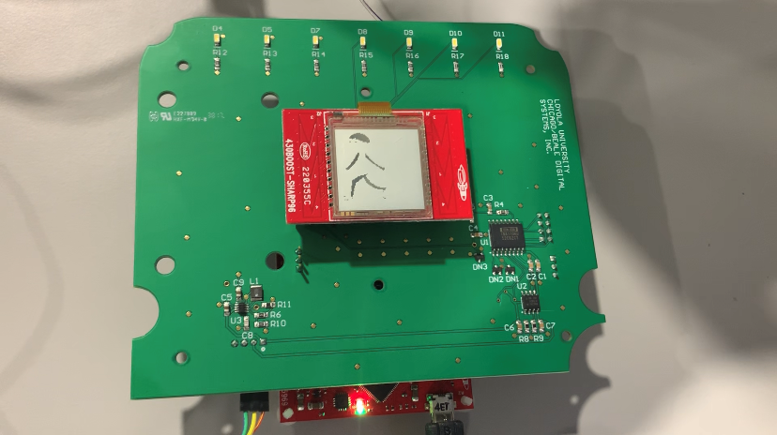

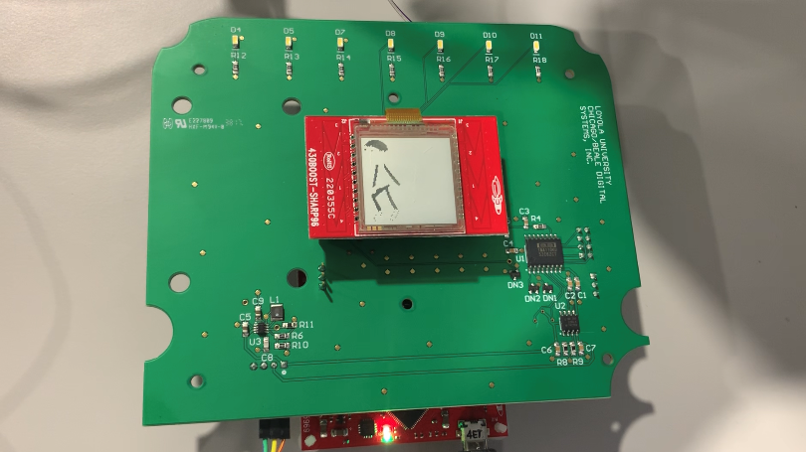
Animation
In order to create the animation part of the cardiograph, we needed to generate images.
extern const helps us import images with external linkages which we used to declare the images.

Slide 6
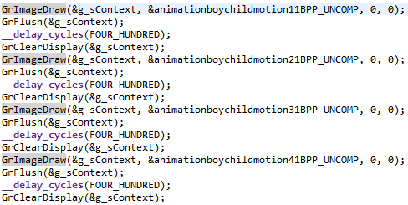
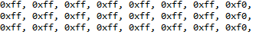
Animation(cont.)
In order to display the images on the screen we needed to call functions to draw it, then to flush which flushes the graphics buffer and allows for the execution of all graphic requests. _delay_cycles(); halts the code and allows the images to be seen for a while(400ms). Once we were done with an image we used GrClearDisplay(); to clear the image.
We also had to fit the image to 96x96 pixel resolution and 2 different shades/colors for the LCD BoosterPack.

Slide 7
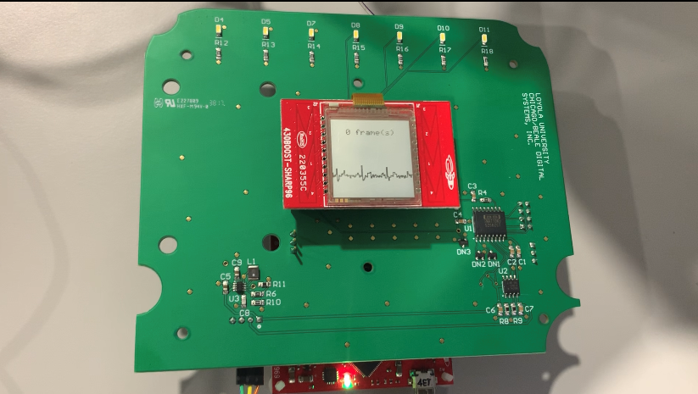
ECG Signal

Slide 8
ECG Signal(cont.)
In LiveECGMode1.c, we used ADC12_B_getResults(); to properly display the ECG signal. The arrows were used to shift the binary values, it’s equivalent to dividing by 2^x to get the new ECG_adc value
The -32 shifts the baseline of the graph. It positioned it towards the bottom of the screen underneath the framecount.
We used 256 as our x for the time interval which gave us about 3 heart beats on the LCD display

Slide 9
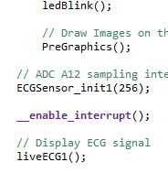
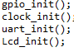
Initializing
Before we can use main.c, we had to initialize different aspects of the board. GPIO, clock, uart, and Lcd were needed in order to run the display.
Now that we fixed the settings and initialized the board we could use the functions and programs, we were now able to implement them in main.c such as ledBlink(), PreGraphics(), and liveECG1() which will ultimately run the program.

Slide 10

Cardiograph

